Slide 1
Island biogeography

Slide 2
Biogeography deals with the geographical distribution of plants and animals. Communities of plants and animals in different geographical areas of the world differ widely from each other.
Or The study of the distribution of organisms in space and time.

Slide 3
Biogeography looks at four fundamental processes:
1. Dispersal: Movement of organism(s) from a point of origin (= location of source, or ancestral, population) to a new location.
2. Colonization: Organism reaches new location, survives, reproduces, and establishes new population.
3. Extinction: Species is eliminated from a particular area (i.e., no more reproducing individuals present); species may survive elsewhere, and may re-colonize area where it went extinct.
4. Evolution: Surviving population in a particular area undergoes change(s) in frequency of gene alleles; may result in altered phenotype, and, given sufficient time, possibly the formation of new species (= speciation).

Slide 4
The theory of island biogeography simply says that a larger island will have a greater number of species than a smaller island. For this theory, an island is any ecosystem that is remarkably different from the surrounding area. So, this could refer to an actual island in the ocean, or it may be an oasis that is surrounded by a desert.
Islands are important natural laboratories for the study of biogeography, ecology, population genetics, evolutionary biology, etc
Early naturalists (e.g., 16th-18th centuries)
exploring isolated islands noted new types of plants and animals, which were often distinctive for each island or island group. For several centuries, scientific focus was on cataloging the diversity of island organisms
More recently, island biogeographers have begun focusing on patterns and mechanisms of evolution of island flora and fauna.

Slide 5
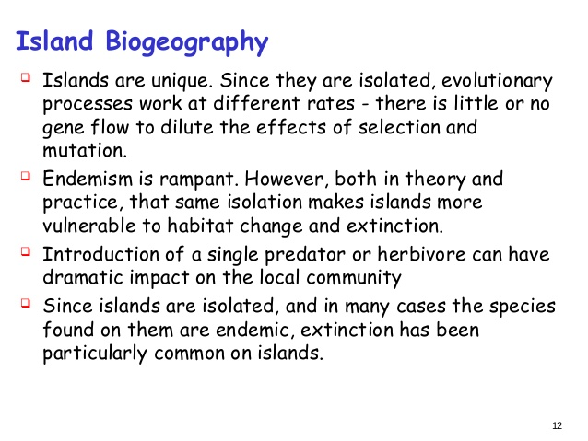

Slide 6
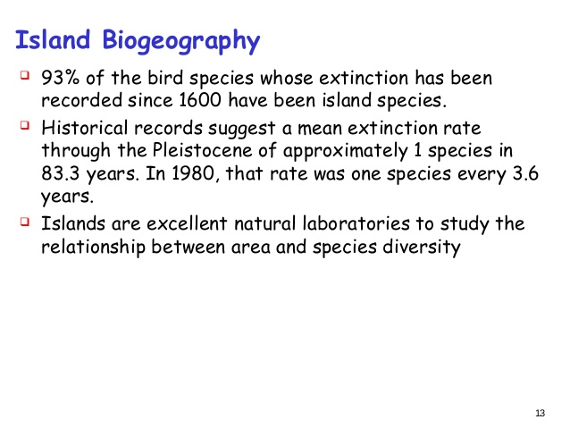

Slide 7
Influences on Species Diversity
When we understand the species diversity within any of these ecological 'islands,' we need to consider three main factors. First is immigration, which is the number of new species that move to the island. When there is a higher rate of immigration, there will be a higher number of species in the island ecosystem. However, immigration rates tend to slow when species diversity becomes higher on the island because of competition.
Next is emigration, which is the number of species that leave the island. Emigration produces results opposite of immigration. As more species emigrate, there is a lower species diversity on the island, and as fewer species emigrate, there will be a higher species diversity.
The third factor is extinction, which is the number of species on the island that become extinct. Extinction rates are related to the size of the island. The smaller the island, the higher the rate of extinction. This is because larger islands contain more resources and habitats, and are thus able to support more life.

Slide 8
Equilibrium
When immigration rates and extinction rates are the same, the island is in equilibrium. This means that the number of species on the island stays roughly the same. However, while the number of species does not change, the composition of those species on the island may change. The rate at which one species is lost and another species takes its place is called the turnover rate.
Environmental factors also affect island biogeography. These factors may be time, weather, natural disasters, human interferences, and the amount of isolation. For example, the longer an island has been isolated, the less species diversity will be present. Likewise, the farther the island is from sources of immigration, the less species diversity will be found in that island. This is because the island is more isolated from other plants and animals that could influence the species composition.

Slide 9
Species-Area Relationship
the species-area relationship - as area increases, the number of species present (diversity) also increases.
The species area curve is expressed mathematically as this model:
S = c A^{z or} logS = logC + z logA
Where S = number of species, A = area, c = constant (=y-intercept of log plot), and z = constant (=slope of the log plot).
As a general rule of thumb, it takes a tenfold increase in the size of a habitat to produce a doubling of the number of species. This rule of thumb does not hold in all cases
What factors influence z?
- Climate, e.g. latitudinal gradient factors
- group of species
- Habitat complexity
- Isolation, e.g. distance from the mainland
- Type of species represented, e.g. mammals vs. birds
Data collected by Harris for mountaintop islands in the Great Basin show that mammals have a higher z (steeper slope on the species-area graph) than birds.

Slide 10
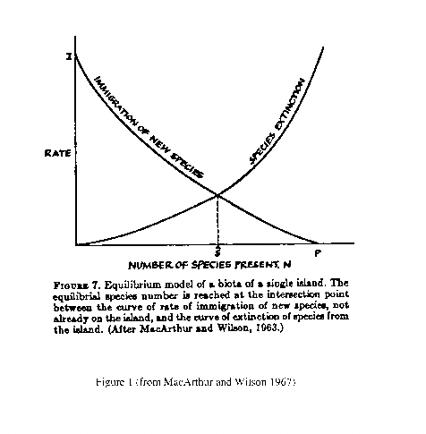
Equilibrium Theory of Island Biogeography (ETIB)
The ETIB describes the theoretical relationship between immigration and extinction of species to islands, depending on their size and distance from the mainland or other species source.
According to ETIB, the number of species present on an island is determined by a balance between immigration and extinction. Generally, as the number of species present increases, the immigration rate decreases and the extinction rate increases.
There are two general relationships to remember:
1) Immigration is higher on near islands than on distant islands (in relation to the mainland), hence the equilibrium number of species present will be greater on near islands.
2) Extinction is higher on small islands than on larger islands, hence the equilibrium number of species present will be greater on large islands.
Therefore,
The number of species on near, large islands > The number of species on distant, small islands

